Slide 1

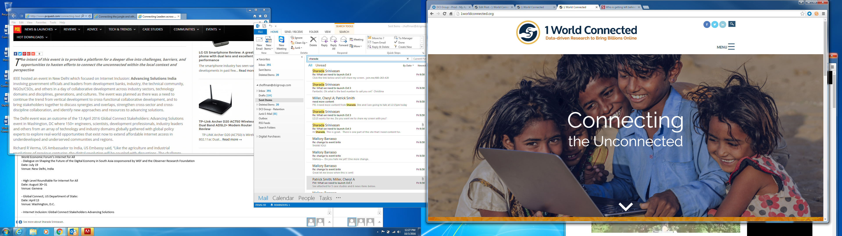

Slide 2

Overview
The Need
Our Goals
Case Studies
Engaging
NRIs

Slide 3
The Need

Slide 4
Our Goals
Conduct three-year project to systematically catalog and analyze the effectiveness of current supply-side and demand-side initiatives to connect the next billion
Develop key learnings about the circumstances under which various approaches are most likely to be effective
Engage with key decision makers to disseminate key learnings and showcase our findings

Slide 5
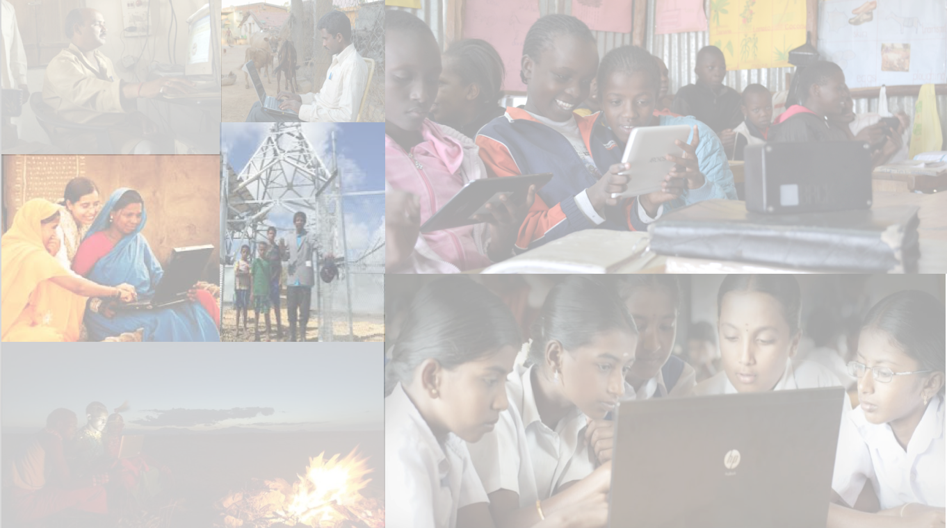
Case Studies
Intel She Will Connect
Mawingu
Comcast Internet Essentials
Rhizomatica
Econet Zimbabwe and Energize the Chain
Rural Communications Project
Wireless for Communities (India)
Tawasol (Tunisia)
Connected Homes (Costa Rica)

Slide 6
The Rural Communications Project
Driving growth by providing access to telecommunications infrastructure in remote areas of Papua New Guinea
Offered one-time subsidy to set up 59 cellular base stations
Provide solar-powered charging stations in areas with minimal electricity
Provide technical assistance to the National Information and Communications Technology Authority (NICTA)
Required total investment of US$ 15 million
Financed by the World Bank and managed by NICTA

Slide 7
The Rural Communications Project Impact
Increased coverage from 20% to nearly 90%
Provides 500,000 people with cellular and Internet coverage
Makes it easier for farmers to obtain agricultural supplies
Provides easier access to emergency services

Slide 8
Econet Wireless Zimbabwe
Providing reliable greenfield power in rural areas at off-grid cellphone towers
Directed at the 590 million people/135 million mobile subscribers in Sub-Saharan Africa who live off-grid
Operates diesel-powered cellphone towers
Provides home solar power for lights, recharging, other accessories (mosquito repellant, television, refrigerator).
Powers vaccine refrigerators in partnership with “Energize the Chain”
(111 off-grid towers in operation, with 100 more under construction)

Slide 9
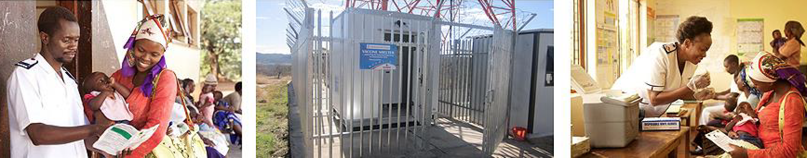
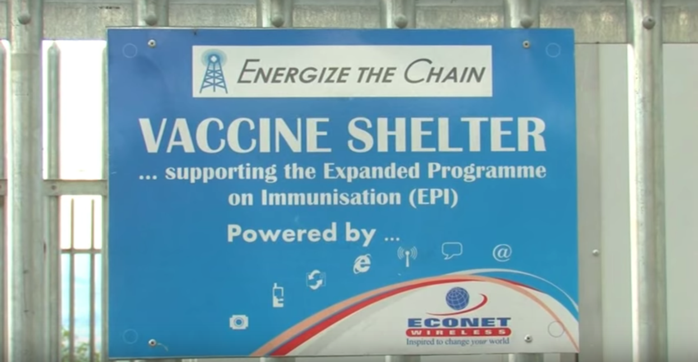
Econet Wireless Zimbabwe Impact
Often provides the first electricity to a community
Offers home electricity for US$ 6 installation and US$ 1 per week
Works with “Energize the Chain” to solve the cold chain problem for vaccines
Vaccinated 250,000 children for preventable diseases

Slide 10
How You Can Be Involved
Feed us stories for our case studies
Spread the word
  Website: 1worldconnected.org
  Facebook: @1worldconnected
  Twitter: 1_WorldConnect
  Instagram: 1worldconnected
  YouTube: 1 World Connected

Slide 11
Upcoming Appearances
ICANN57, Hyderabad (November 3-9)
IGF Guadalajara (December 5-9)
  Day 0 event (with IEEE, WEF, ISOC, ITU, World Bank: Advancing Solutions for Connectivity)
  Day 1 workshops (10:45-11:45, 12:00-13:30)
  Day 2 Dynamic Coalition session (16:00-18:30)
  Booth (open all days)

Slide 12

Thank you!
Contact: csyoo@law.upenn.edu
sharadas@law.upenn.edu
Notes:
Final logo to be inserted

