Slide 1



A Z E R B A I J A N
How to work together at the regional level – projects, forums and capacity building programs for innovative progress in ICT and Transport

Slide 2

Why Azerbaijan is the Regional Hub of ICT & Innovation?
1
ICT sector of Azerbaijan has expanded twice per three years within 2004-2017
2
2017 the extent of Internet access increased to 70 percent (Leading CIS Country)
3
ICT market has soared from 67 % in 2003 to 90% in 2017
4
Innovation Week 2018 was organized where more than 15 events were convened and 1000 participants gathered
5
Fixed-line network has increased from 48 percent in 2003 to 100 percent in 2017
6
The growth rate of the ICT sector in 2017 was 18% which is 2,5 times more than worldwide average growth rate
7
The “Azerspace” - first telecommunications satellite launched on 8th of February 2013

Slide 3
Activities
Stratigic outline
Tactical action plan
1
Developing key strategy and having pivotal role to deliver Sustainable Development Goals (SDGs);
Develop National Capability Development of the ICT & Transport;
Become an international focal point for ICT & Innovation;
Strengthen in the medium and long term ICT capacity building amongst government officials;
Provide innovative and long-term arrangements for developing ICT infrastructure;
Provide ICT public services through infusion of private sector funds;
2
Identify best practice in the design and implementation of innovation in the ICT sector;
Establish a knowledge management platform to improve the evaluation of innovation projects regarding ICT sector;
Analyzing the best practices regarding the development of human resources via ICT;
Convening and coordination of the innovation trainings;
Organization, hosting, and funding regular symposiums, workshops, seminars and other relevant events on innovation by close collaboration with the UN;

Slide 4
Future Plans
1
Building strong affairs and active intercourse with UN & IGF Secretariat regarding the establishment of the Public – Private Partnership (PPP) Specialist Centre on Innovation in the Republic of Azerbaijan;
2
Conducting regular meeting with IGF Secretariat;
3
Probe for the additional stakeholders regarding the upcoming innovation projects of Azerbaijan;
Preparation and publication of reports, prints and audio/video datas regarding Innovation for public information;
4
5
Creation and launching of the Global Website for all PPP Specialist Centres via close cooperation with UNECE;
6
Develop political/social/economic corroboration and benefits of the Public – Private Partnership (PPP) Specialist Centre on Innovation in the Republic of Azerbaijan;
7
Convening and management of the International Conference on capacity building to support the establishment of the PPP Specialist Center for Innovation 2019 in Baku, Azerbaijan;

Slide 5
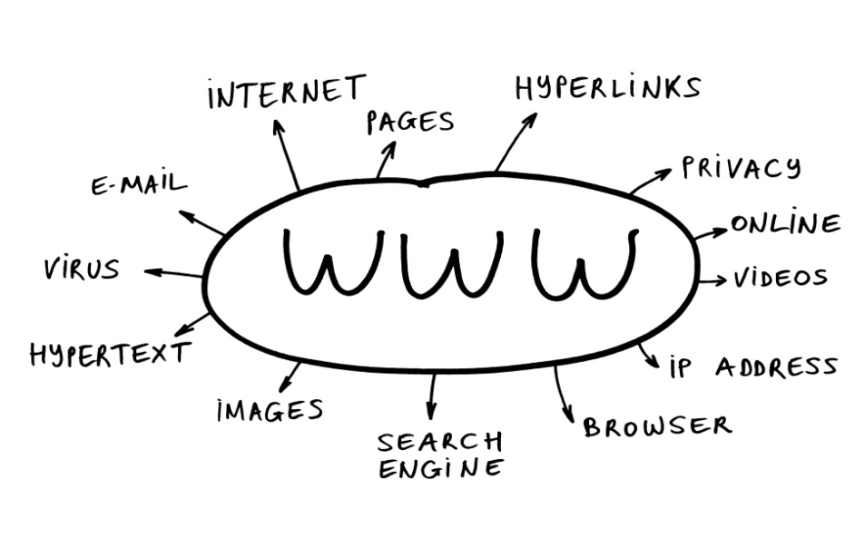
Challenges
Analyze the potential risks and impediments for the proper operation of the activities regarding the innovation projects in Azerbaijan;
Preparation of the country specific activities plan (roadmap) within the overall visibility plan in line with the Public – Private Partnership (PPP) Specialist Centre on in the Republic of Azerbaijan;
Preparation of proposals regarding the management structure for the Public – Private Partnership (PPP) Specialist Centre on ICT/Broadband in the Republic of Azerbaijan in accordance with UNECE procedures;

Slide 6
How to work together at the regional level – projects, forums and capacity building programs for innovative progress in ICT and Transport
Activities
Future Plans
Challenges

Slide 7
Thank You For Your Kind Attention
Innovation
Private
Public
Mr. Vasif Mammadov
Project Manager
UNDP CO Azerbaijan/ MTCHT
Email: vasif.mammadov@undp.org

